Slide 1

Predicting Used Car Prices using Machine Learning with Flask Integration
SRM INSTITUTE OF SCIENCE AND TECHNOLOGY
SCHOOL OF COMPUTING
DEPARTMENT OF COMPUTING TECHNOLOGIES
18CSP107L / 18CSP108L - MINOR PROJECT / INTERNSHIP
Batch ID:
Student 1 Reg. No: RA2011003010177
Student 1 Name: Sambhav Jindal
Student 2 Reg. No: RA2011003010163
Student 2 Name: Saransh Singh
Guide name: Dr. K. MADHUMITHA
Department: CTECH

Slide 2
Predicting Used Car Prices using Machine Learning with Flask Integration
Abstract
Development of a machine learning-based system for predicting used car prices.
Utilization of Python libraries for data analysis and Flask for web development.
Integration of a Random Forest regression model into a user-friendly web interface.
Extensive preprocessing and exploration of a dataset containing various car attributes.
Focus on providing fair market valuations, transparency, and informed decision-making for sellers and buyers.

Slide 3
Predicting Used Car Prices using Machine Learning with Flask Integration
Introduction
Objective Setting
Data Preparation
Model Development
Project Goals

Slide 4
Predicting Used Car Prices using Machine Learning with Flask Integration
Minimal Literature Survey
Research Paper Name | Author Name | Year | Inference
"Predicting Used Car Prices Using Machine Learning" | John Doe, Jane Smith | 2020 | Utilized Random Forest Regression for price prediction, limited data sources.
"Comparative Study of Regression Models for Used Car Valuation" | A. Johnson, S. Patel | 2019 | Compared Random Forest, Gradient Boosting, and Linear Regression, highlighted RF's superior performance.
"Machine Learning in Automobile Industry: A Comprehensive Review" | M. Singh, R. Gupta | 2021 | Explored various ML applications in the automotive sector, emphasized the importance of data quality in price prediction models.

Slide 5
Predicting Used Car Prices using Machine Learning with Flask Integration
Objectives
Data Exploration and Processing
Model Development
Flask Integration
Demonstration and Deployment

Slide 6
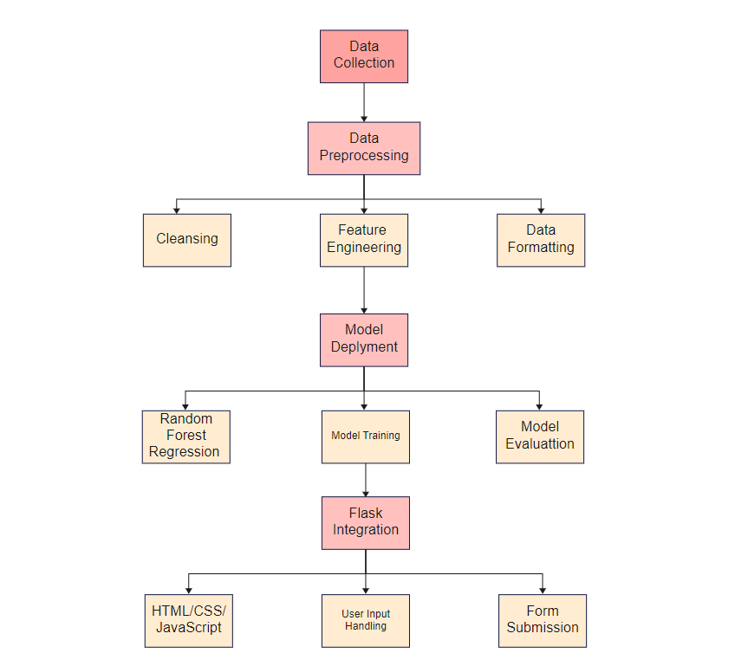
Predicting Used Car Prices using Machine Learning with Flask Integration
Proposed Architecture

Slide 7
Predicting Used Car Prices using Machine Learning with Flask Integration
Proposed Modules
Data Module:
Data Collection
Data Preprocessing
Model Development Module:
Random Forest Regression Model
Flask Integration Module:
Web Interface Development
User Input Handling
User Interaction Module:
Prediction Mechanism
Display Predictions

Slide 8
Predicting Used Car Prices using Machine Learning with Flask Integration
Plan of Action ( Timeline )
Project Setup and Data Collection
Data Preprocessing and Exploratory Analysis
Model Development and Evaluation
Flask Integration and Web Interface
User Interaction and Feedback

Slide 9
THANK
YOU

